Slide 1


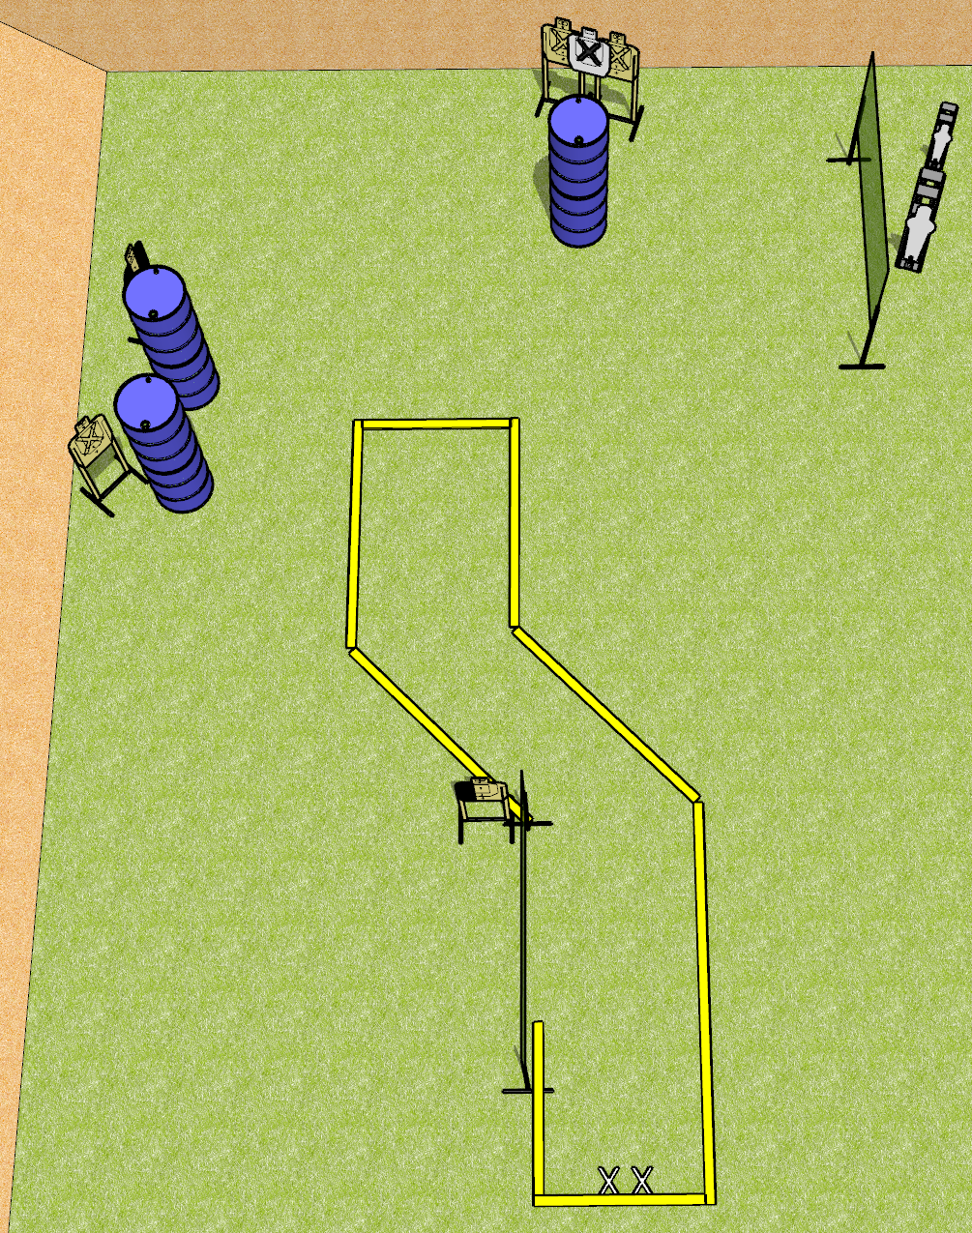
 | Dothan Gun Club – USPSA Match Side Step Course Designer : Drew Coleman
START POSITION : Standing facing uprange, feet on X’s, toes against rear fault line. Wrists above respective shoulders
GUN READY CONDITION : Pistol loaded and holstered. PCC shouldered facing downrange, buttstock on belt, heels on rear fault line |  | SCORING: Comstock, 12 rounds TARGETS: 5 paper, 2 Steel SCORED HITS: Best 2 on paper, steel until down START-STOP: Audible, last shot RULES:
STAGE PROCEDURE: Engage targets as they become available from within the fault lines

Slide 2
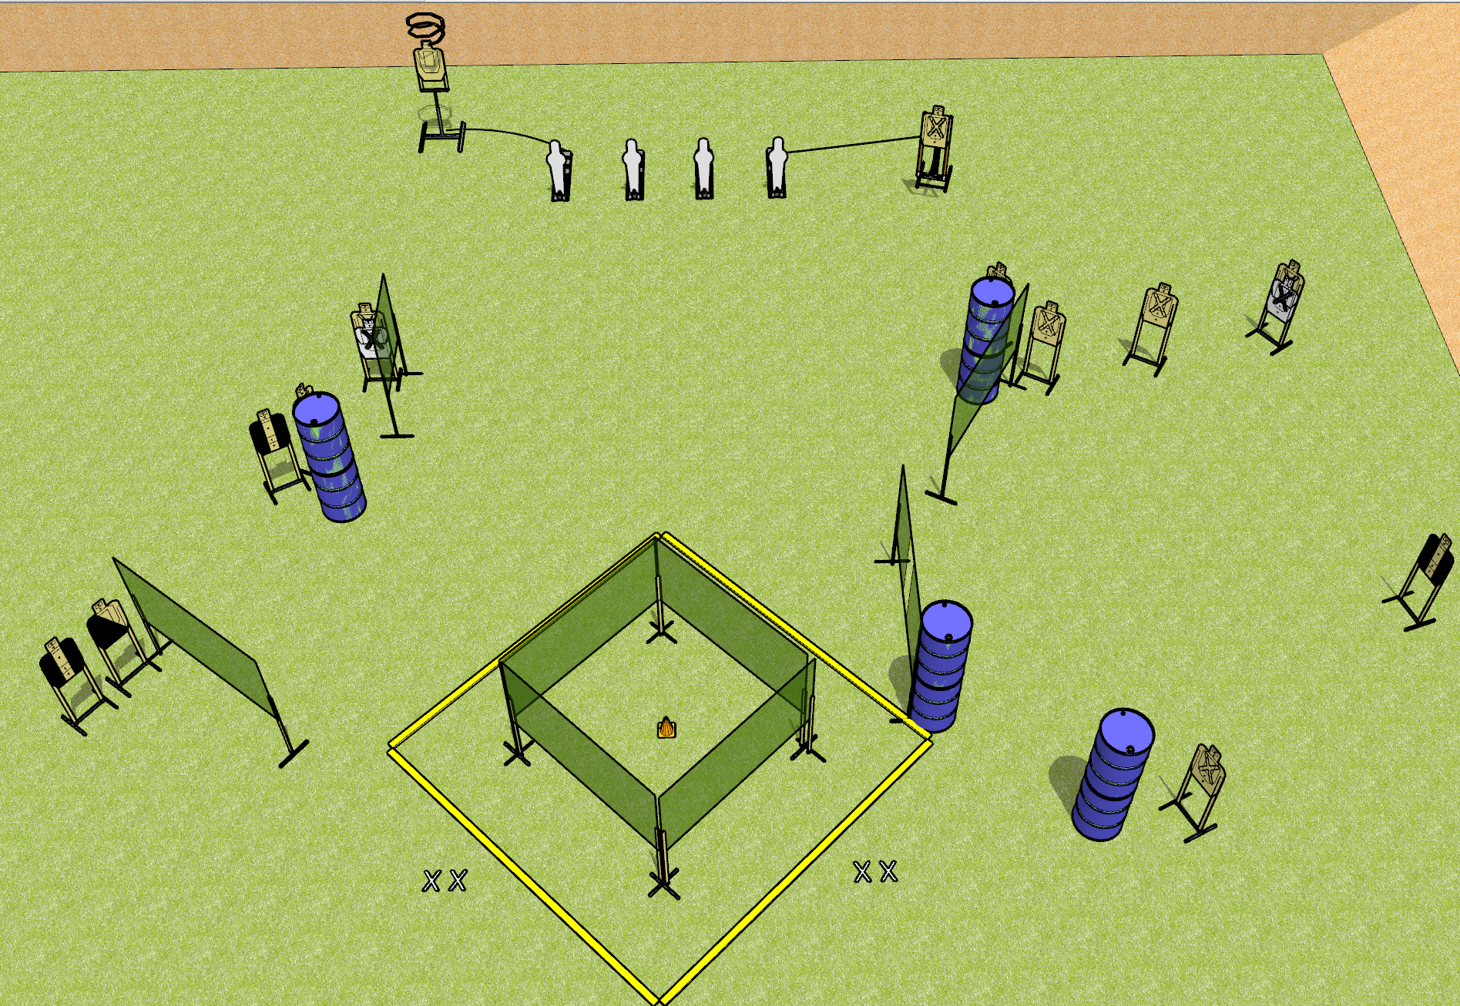
 | Dothan Gun Club – USPSA Match Circling the Drain Course Designer : Drew Coleman
START POSITION : Standing with both feet on X’s, wrists below belt
GUN READY CONDITION : Pistol loaded and holstered. PCC loaded, shouldered, safety on, pointed at orange cone. |  | SCORING: Comstock, 30 rounds TARGETS: 13 paper, 4 Steel SCORED HITS: Best 2 on paper, steel until down START-STOP: Audible, last shot RULES: Drop turner is disappearing
STAGE PROCEDURE: Engage targets as they become available from within the fault lines.

Slide 3
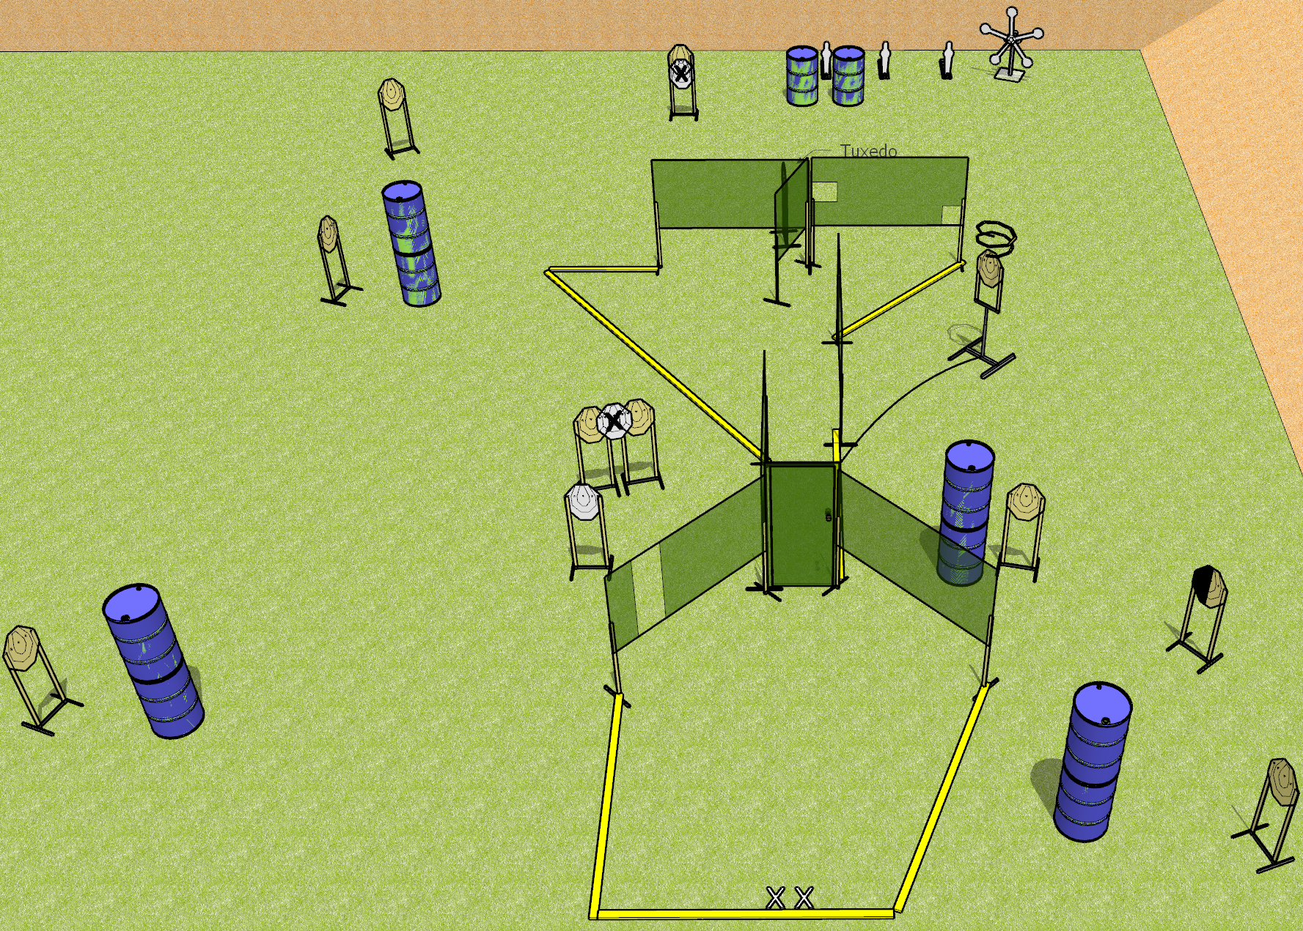
 | Dothan Gun Club – USPSA Match Do the Thing Course Designer : Drew Coleman
START POSITION : Standing with both feet on X’s. Hands relaxed at sides.
GUN READY CONDITION : Pistol loaded and holstered. PCC shouldered, safety on, pointed at door |  | SCORING: Comstock, 30 rounds TARGETS: 11 paper, 8 Steel SCORED HITS: Best 2 on paper, steel until down START-STOP: Audible, last shot RULES:
STAGE PROCEDURE: Engage targets as they become available from within the fault lines

Slide 4
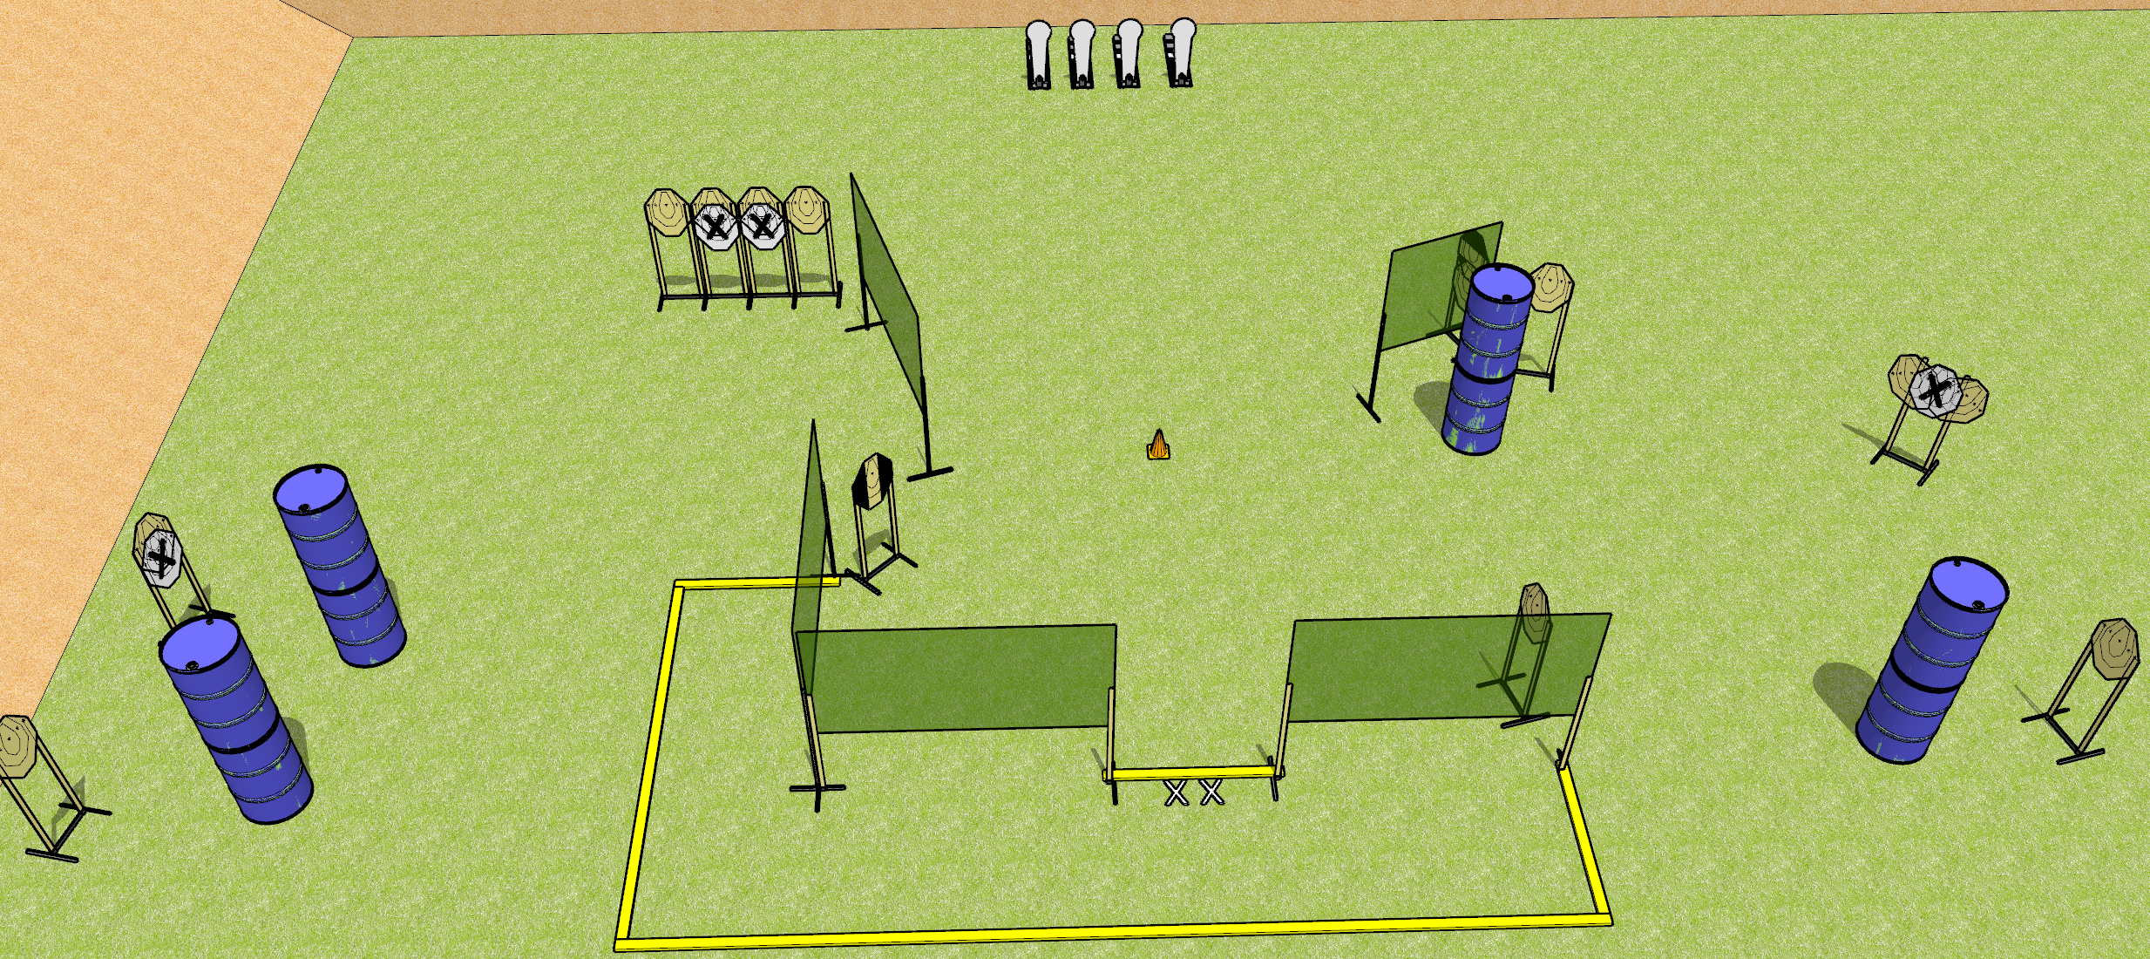
 | Dothan Gun Club – USPSA Match Pain for Dinner Course Designer : Drew Coleman
START POSITION : Standing with both feet on X’s. Hands relaxed at sides.
GUN READY CONDITION : Pistol loaded and holstered. PCC buttstock on belt, safety on, pointed at orange cone. |  | SCORING: Comstock, 32 rounds TARGETS: 14 paper, 4 Steel SCORED HITS: Best 2 on paper, steel until down START-STOP: Audible, last shot RULES:
STAGE PROCEDURE: Engage targets as they become available from within the fault lines

Slide 5
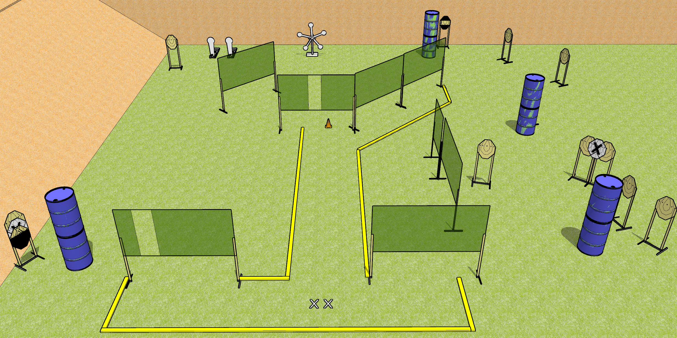
 | Dothan Gun Club – USPSA Match Turtles Everywhere Course Designer : Drew Coleman
START POSITION : Standing with both feet on X’s. Hands relaxed at sides.
GUN READY CONDITION : Pistol loaded and holstered. PCC shouldered, safety on, pointed at orange cone. |  | SCORING: Comstock, 31 rounds TARGETS: 12 paper, 7 Steel SCORED HITS: Best 2 on paper, steel until down START-STOP: Audible, last shot RULES:
STAGE PROCEDURE: Engage targets as they become available from within the fault lines

Slide 6
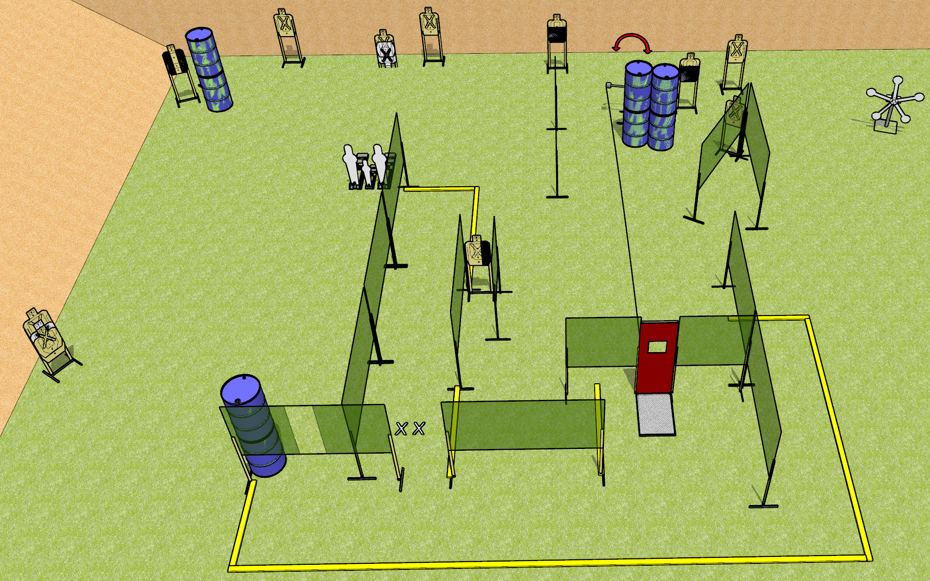
 | Dothan Gun Club – USPSA Match Don’t Mess With Me Course Designer : Drew Coleman
START POSITION : Standing with both feet on X’s, wrists below belt
GUN READY CONDITION : Pistol loaded and holstered. PCC loaded, shouldered, safety on, pointed at orange cone. |  | SCORING: Comstock, 34 rounds TARGETS: 14 paper, 8 Steel SCORED HITS: Best 2 on paper, steel until down START-STOP: Audible, last shot RULES:
STAGE PROCEDURE: Engage targets as they become available from within the fault lines.

